Slide 1

Home automation using NodeMCU
DAY 28
EMBEDDED SYSTEM DESIGN & IoT-Master Class

Slide 2
What You will learn Today?
What is blynk app
Home automation using NodeMCU

Slide 3
Mindset Lesson for the Day
Learn,Unlearn,Relearn

Slide 4
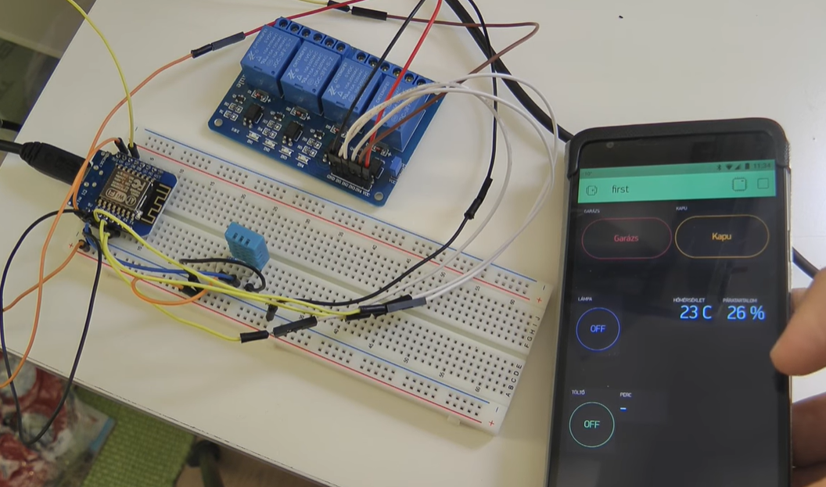
Home automation using NodeMCU

Slide 5
HARDWARE REQUIREMENTS
NodeMCU
Relays
DHT11
Light bulb and cooling fan

Slide 6
SOFTWARE REQUIREMENTS
Arduino IDE
Blynk app

Slide 7
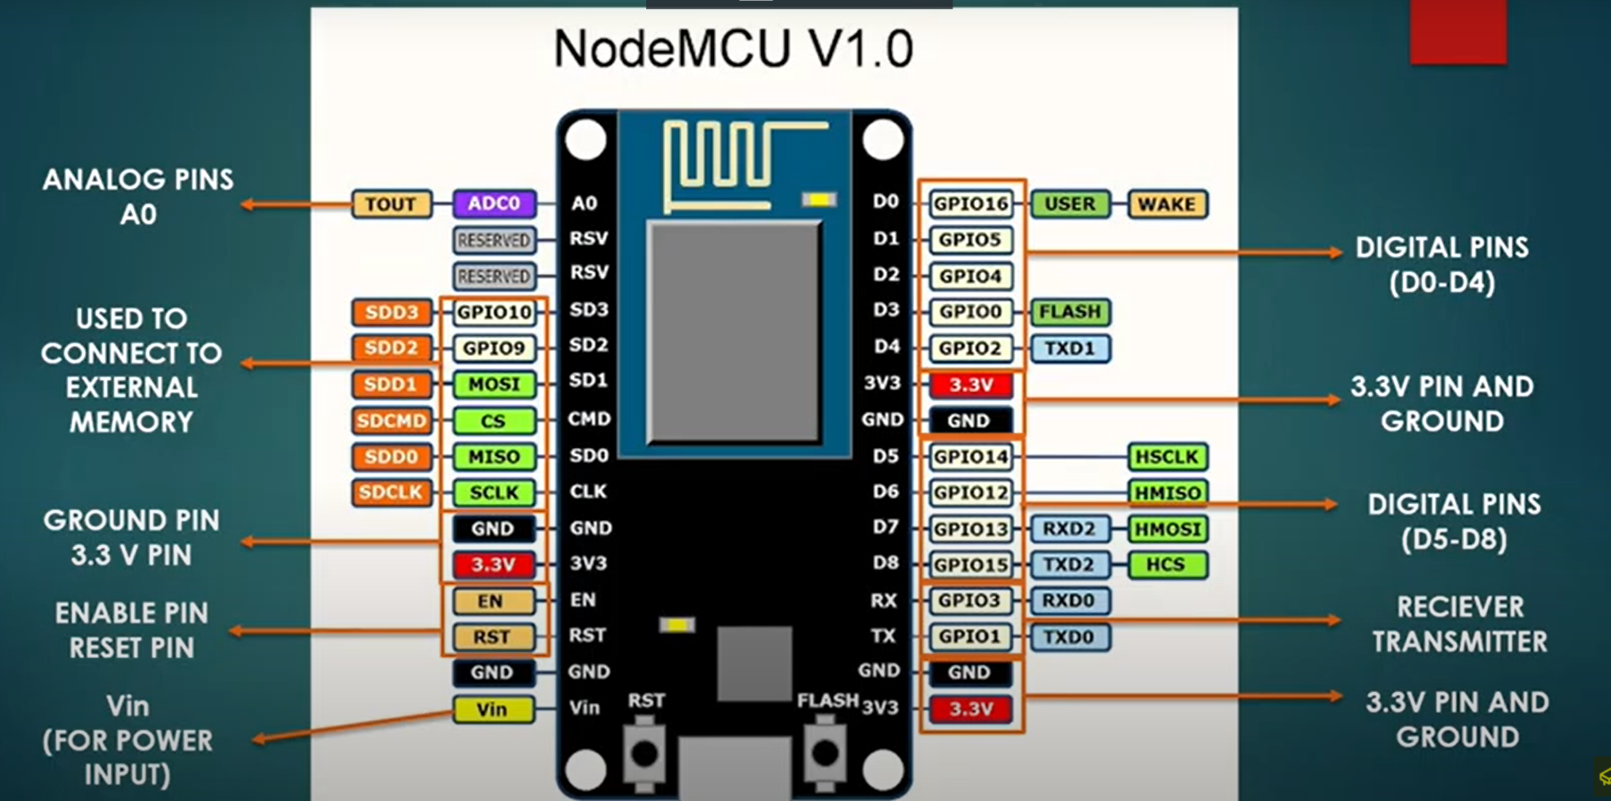
Node MCU V 1.0

Slide 8
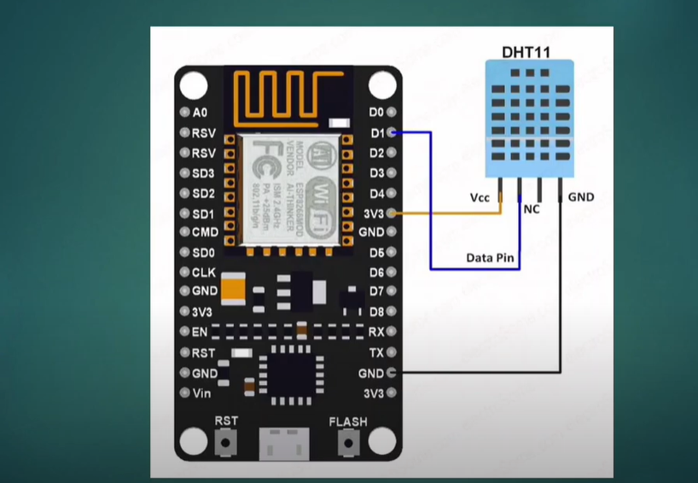
Interface with DHT11

Slide 9
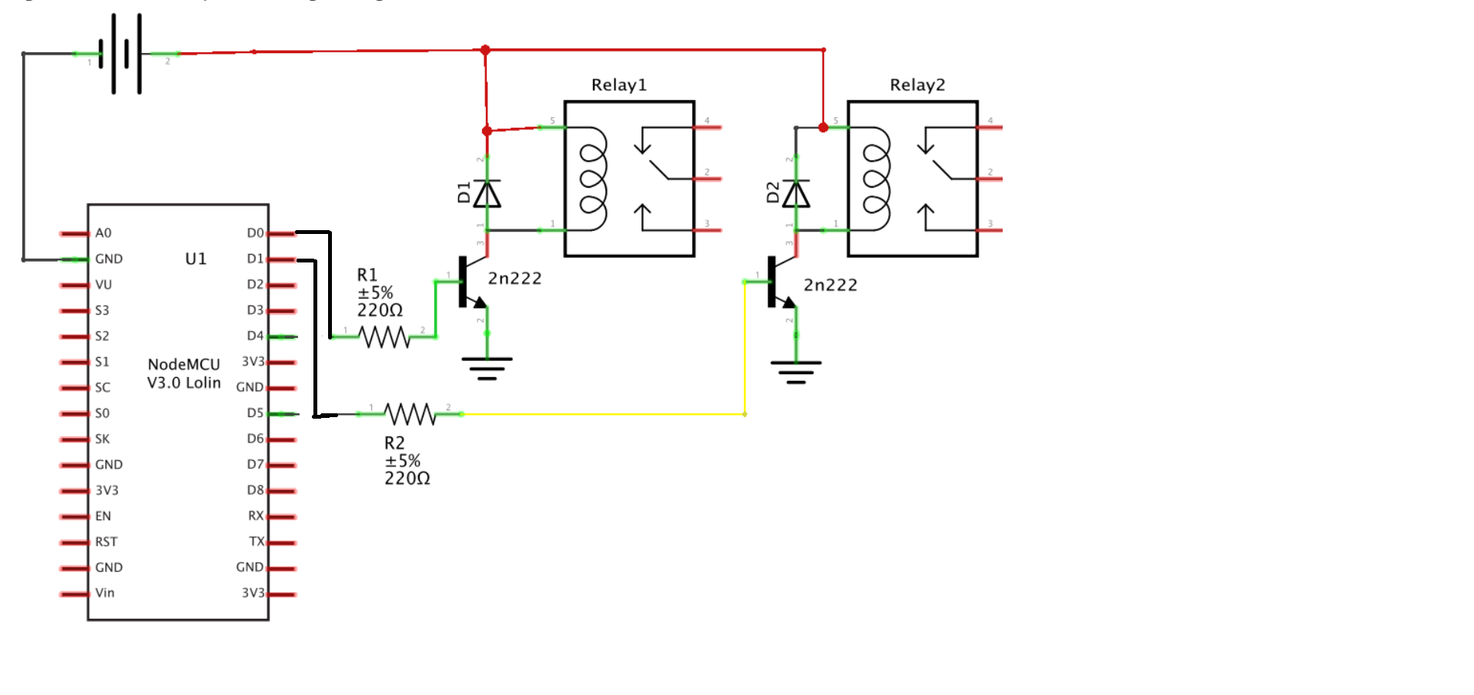
Interface with Relay

Slide 10
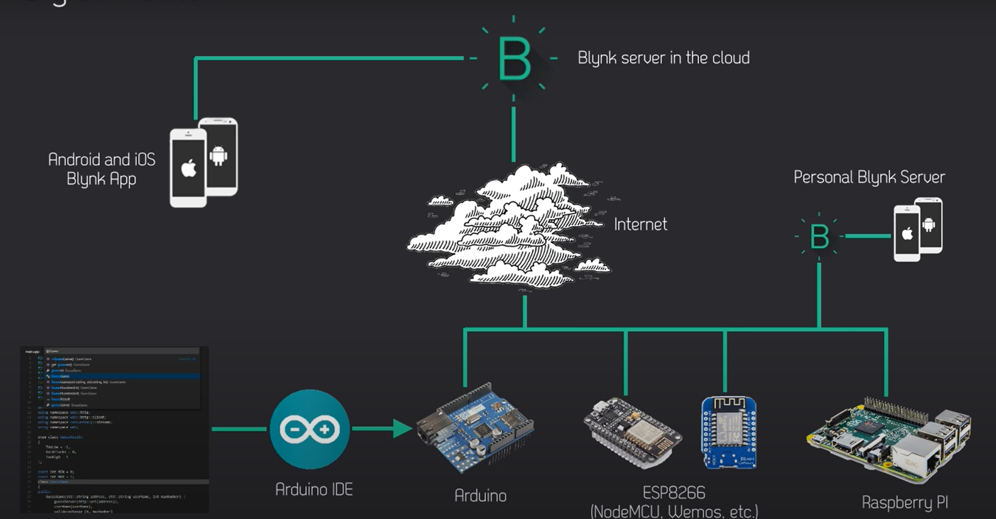
How Blynk works

Slide 11
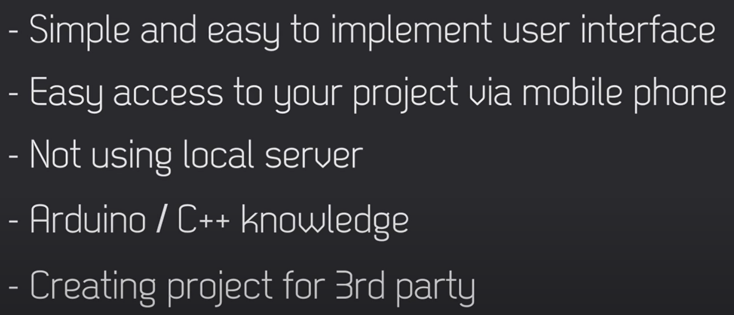
When to use Blynk free

Slide 12
DEMO

Slide 13
Thank You

